Slide 1
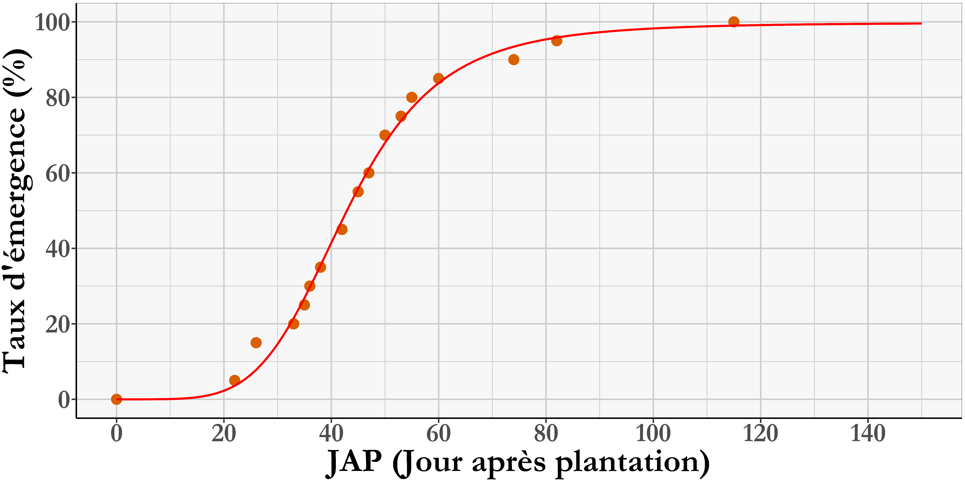
Latence
EM5_95
EmergMax
EM50
PenteEmerg
(proportionnel à la pente de la tangente au point d’inflexion)

Slide 2
Latency
Emergence duration
Maximum emergence
Rate of emergence (%)
Time to 50% of maximum emergence
Emergence slope
DAP (days after planting)

Slide 3
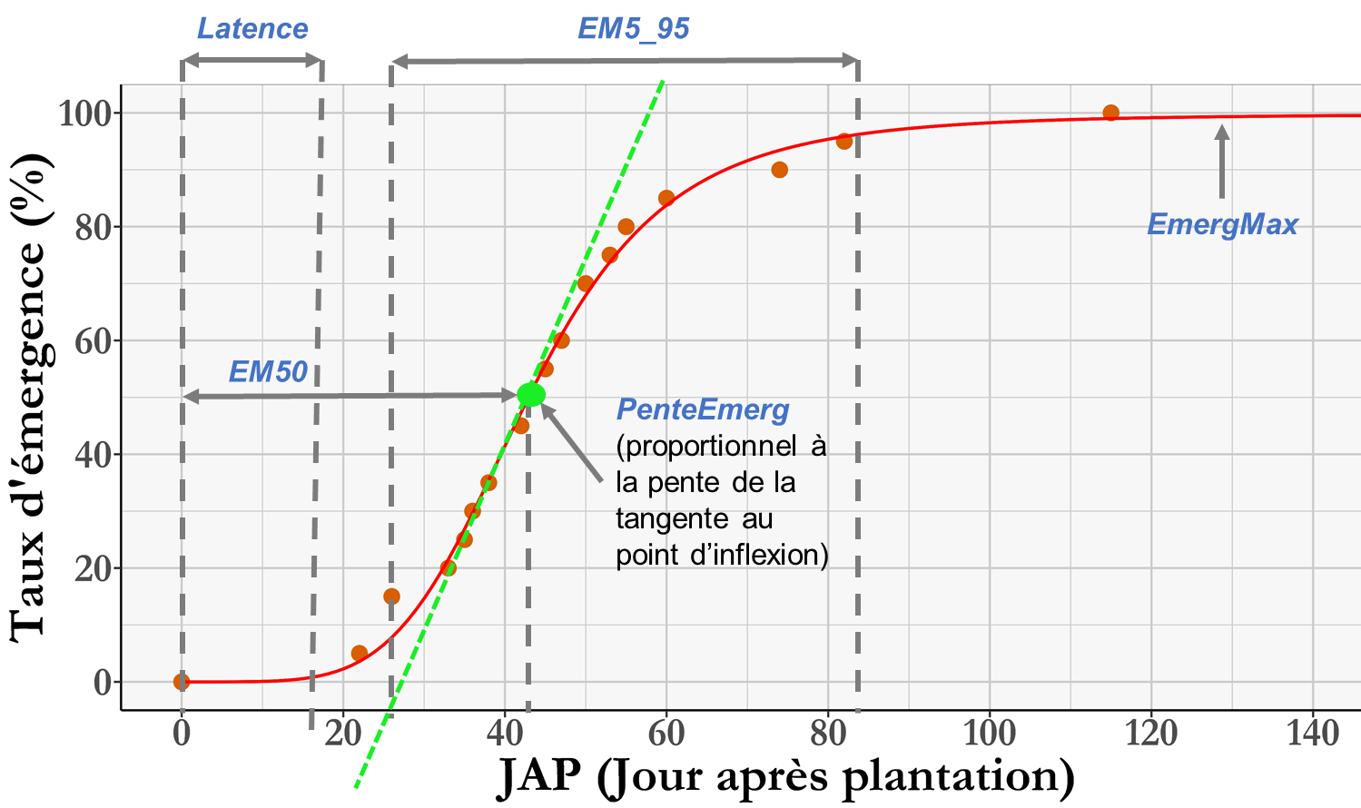

Slide 4

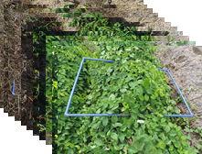
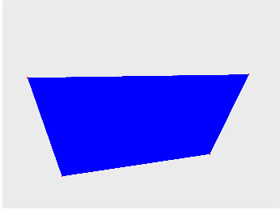

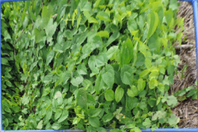

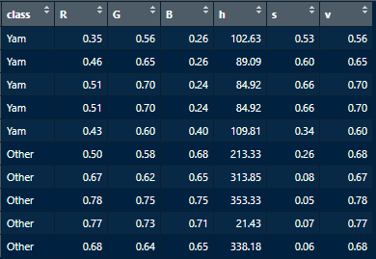
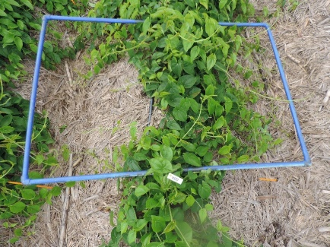

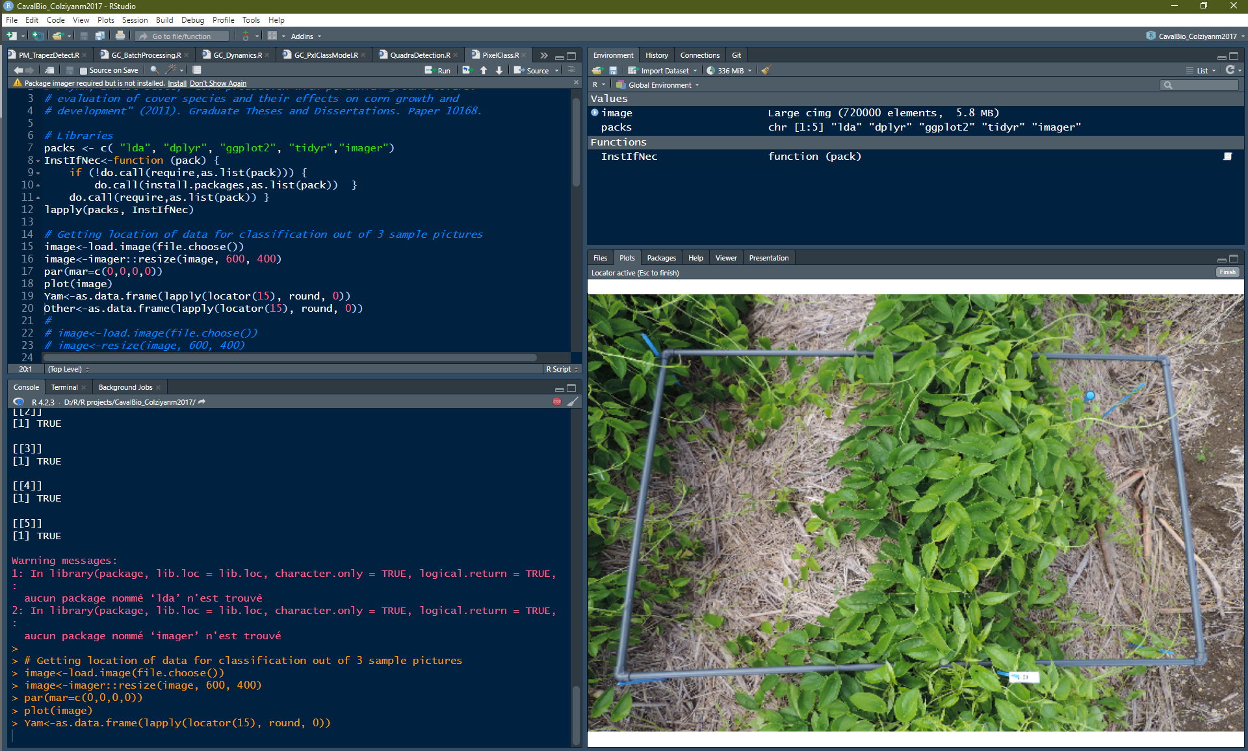
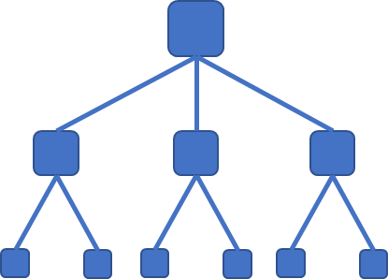



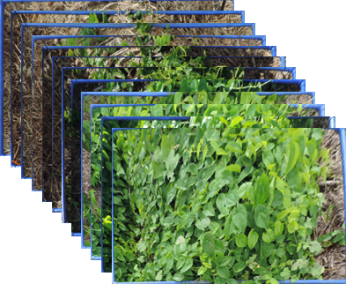
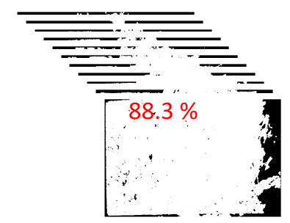
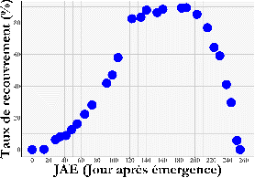

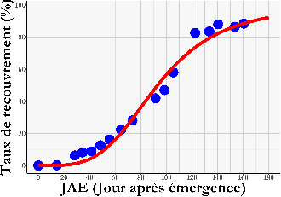
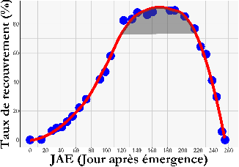
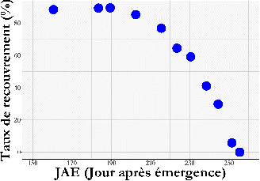
YAM-GROP PIPELINE
Image acquisition
Frame detection and convex hull
Determination of the transformation matrix
Image geometry correction
1. PRETRAITEMENT
Correction of geometry
Manual classification of a subset of representative pixels
Extraction of pixel colour values
Random forest calissification model calibration
2. CLASSIFICATION
Segmentation using model correspondance
Crop cover
Back-ground
Time series of pretreated images
Ground cover prediction (%) using random forest
Ground cover longitudinal estimation
3. SEGMENTATION
Correspondence model
0%
Speed and maximum ground cover
Growth cycle and plateau of maximum cover durations
Senescence duration
4. INTERPRETATION
Ground cover dynamic
+
+

Slide 5
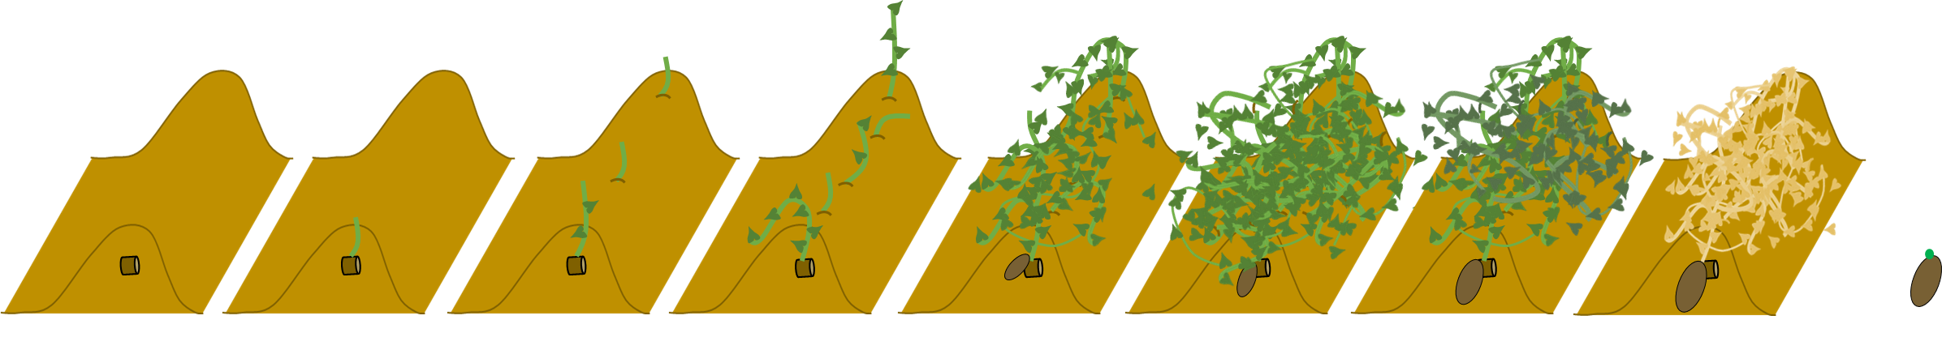
Vigueur d’émergence
Dynamique de recouvrement
Cycle de l’igname
Latence
Croissance
Plateau
Senescence
Dormance
EM5_95
Rec50
Cycle
EM50
100% émergence
Maximum de croissance
100% sénescence
1ère émergence
50% recouvrement
Plantation
50% émergence
Initiation sénescence
Germination

Slide 6
Emergence vigor
Ground cover dynamic
Yam cycle
Latency
Growth
Plateau
Senescence
Dormancy
EM5_95
Rec50
Crop cycle
EM50
100% emergence
Maximum growth
100% senescence
1st emergence
50% of maximum ground cover
Plantation
50% emergence
Senescence onset
Germination

Slide 7
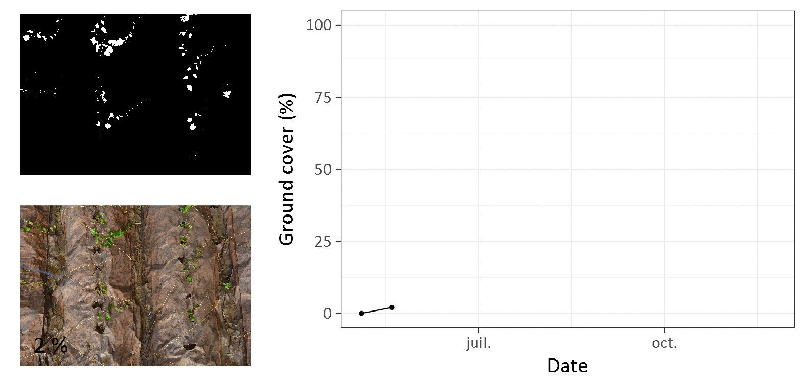

Slide 8
